Slide 1

Enhancing ecoSysteM sERvices mApping
for poLicy and Decision mAking
Project coordinator: Benjamin Burkhard, Kiel University
EU Horizon 2020 Coordination and support action

Slide 2
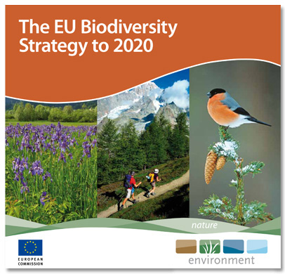
Project background: EU Biodiversity Strategy to 2020
Target 2:
  “to improve knowledge of ecosystems and their services in the EU (Action 5) – the member states shall map and assess the state of ecosystems and their services in their national territory by 2014, assess the economic value of such services, and promote the integration of these values into accounting and reporting systems at EU and national level by 2020”
http://ec.europa.eu/environment/nature/biodiversity/comm2006/2020.htm

Slide 3
Objective and targets
EU Horizon 2020 topic addressed:
Enhancing mapping ecosystems and their services
Subcall SC5-10a-2014 of H2020-SC5-2014 call on Growing a Low Carbon, Resource Efficient Economy with a Sustainable Supply of Raw Materials
ESMERALDA targets:
Ecosystem Services (ES) mapping and assessment strategies for EU member states
Deliver a ‘flexible methodology’ for pan-European, national and regional ES mapping and assessment
Support the timely delivery by EU member states of Action 5 of the EU Biodiversity Strategy 2020 by supporting EU MS stakeholders (i.e. national Action 5 authorities)
Promote local ES assessments required for spatial planning, agriculture, climate, water and nature policy
Transmit experience through active dialogues and co-creation of knowledge
Mobilise all relevant actors, increase participation of citizens in science and decision making
Develop a Strategic Research Agenda (SRA) for ES mapping and assessment throughout and beyond Horizon 2020

Slide 4

Relation to other projects and ongoing activities
ESMERALDA is an additional project (Support & coordination action funded by EC DG Research & Innovation) to support EU member states in Action 5 tasks
Builds on/co-operates with e.g. MAES, OpenNESS, OPERAs, MESEU
National and regional studies (UK NEA, TEEB-DE, MAES-DE)
Coordination and streamlining existing European ES research
Exchange of information, data and methods
Strengthen existing networks and create new European collaborations between ES scientists, practitioners and policy makers
Improve the science-policy-society interface
Link European and national research and funding activities with international activities (such as ESP) - create synergies
ES mapping and assessment methods for all EU member states (incl. the outermost regions and marine areas)
Enhance methods, integrating biophysical, social and economic techniques
Enable long-term ES-based management strategies throughout and beyond Horizon 2020

Slide 5
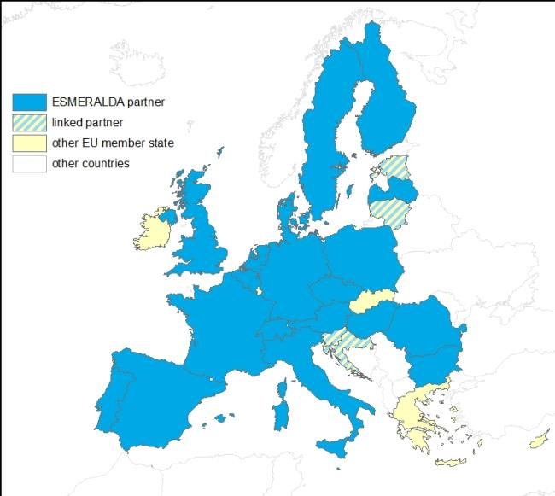

ESMERALDA consortium
25 project partners
20 European countries
2 linked Baltic countries
2 linked western Balkan countries
+ further member states addressed already
44 % university partners
28 % state or other superior organisations
16 % from other academia
12 % SMEs

Slide 6
ESMERALDA consortium
No | Participant organisation name | Lead contact | Code | Country
1 | Christian Albrechts University Kiel | Benjamin Burkhard | CAU | DE
2 | Finnish Environment Institute | Leena Kopperoinen | SYKE | FI
3 | University of Madrid | Fernando Santos | UAM | ES
4 | University of Nottingham | Marion Potschin | UNOTT | UK
5 | University of Trento | Davide Geneletti | UNITN | IT
6 | Pensoft | Lyubomir Penev | PENSOFT | BG
7 | Free University of Amsterdam | Roy Brouwer | VU | NL
8 | Flemish Institute for Technological Research | Steven Broekx | VITO | BE
9 | Bulgarian Academy of Sciences | Stoyan Nedkov | NIGGG BAS | BG
10 | Global Change Research Centre | David Vačkář | CVGZ | CZ
11 | Foundation for Sustainable Development | Rudolf de Groot | FSD | NL
12 | ETH Zürich | Adrienne Grêt-Regamey | ETH Zurich | CH
13 | Baltic Environmental Forum | Anda Ruskule | BEF | LV
14 | Regional Environmental Centre | Sasa Solujic | REC | HU
15 | Hungarian Academy of Sciences | Bálint Czúcz | MTA OK | HU
16 | Instituto Superior Técnico | Cristina Marta-Pedroso | IST | PT
17 | University of Bucharest | Adamescu Cristian Mihai | UB | RO
18 | UNEP WCMC | Neil Burgess | WCMC | UK
19 | Paris-Lodron University Salzburg | Hermann Klug | PLUS | AT
20 | University of Poznan | Andrzej Mizgajski | UPOZ | PL
21 | Institute for Environmental & Agricult. Science & Research | Sandra Luque | IRSTEA | FR
22 | Malta College of Arts, Science and Technology | Mario Balzan | MCAST | MT
23 | University of Copenhagen | Tobias Plieninger | UCPH | DK
24 | Naturvårdsverket | Hannah Östergård | SEPA | SE
25 | Joint Research Centre | Joachim Maes | JRC | EU

Slide 7
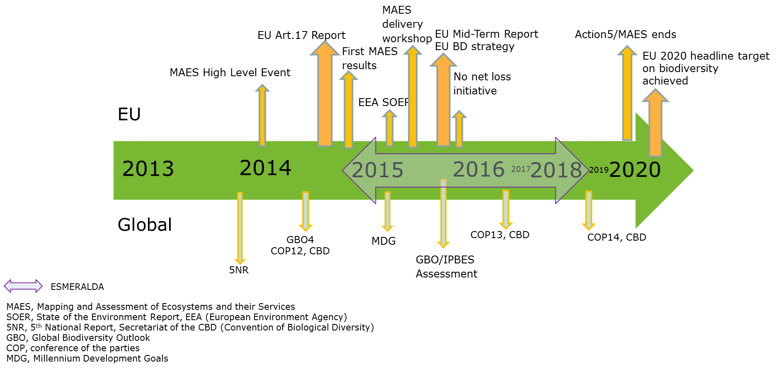
ESMERALDA timeplan
Project start: 01.02.2015
Project duration: 42 months
Timeline showing the integration of ESMERALDA in related EU and global activities:

Slide 8
ESMERALDA working phases
1st phase: Identification of relevant stakeholders and stocktaking, collecting and linking existing approaches for ES mapping and assessment, creating links to existing related projects and databases;
2nd phase: Development of the multi-tiered ES mapping and assessment methodology;
3rd phase: Testing the developed methodology in representative thematic and biome-oriented Workshops and Case studies across EU member states;
4th phase: Feedbacks from ESMERALDA stakeholders and other relevant user groups, methodology improvement;
5th phase: Producing tailored and flexible solutions for ES mapping and assessment for policy and decision making;
6th phase: Safeguarding the implementation of project results in the context of the BD Strategy and Horizon 2020, including strategies for long-term implementation beyond ESMERALDA

Slide 9
ESMERALDA political relevance
Bringing ES into application at the science-policy-society interface is not only dependent on raising awareness
ESMERALDA will provide tools to demonstrate how ES approaches can make a difference
Creating a network of stakeholders, practitioners, researchers and policy makers
ESMARALDA will substantially enhance and support work under Action 5 in EU
Increase ES approach’s applicability in EU and national policies having impact on natural resources

Slide 10

Thank you for your attention:
Thank you for your attention!
We look forward to future co-operation!
Contact: bburkhard@ecology.uni-kiel.de
This project receives funding from the European Union’s Horizon 2020 research and innovation programme under grant agreement No 642007.

